Slide 1
Welcome to Machine Learning Developer Summit – MLDS 2022 (Fourth Edition) by Association of Data Scientists

Slide 2
Information Preserving Frame-based Convolutional Image Interpretation - IPFCII
Vasudeva Kilaru – Machine Learning Intern Student at Lovely Professional University

Slide 3
Interpretation of data to Neural Networks
Data
Structured Data
Unstructured Data
Text
Excel sheets
Etc.
Audio
Image
Video
Etc.

Slide 4
A Brief History on Methods of Data Interpretation to Neural Nets
Methods of Interpreting Structured Data to Neural Networks:
1. Interpreting tabular data to neural networks is done through fully connected layers such that the features of tabular data are input features ‘x’ to the first fully connected layer.
Methods of Interpreting Unstructured (Image) Data to Neural Networks:
1. Interpreting image data through fully connected layers
2. Interpreting image data through convolutional layers

Slide 5
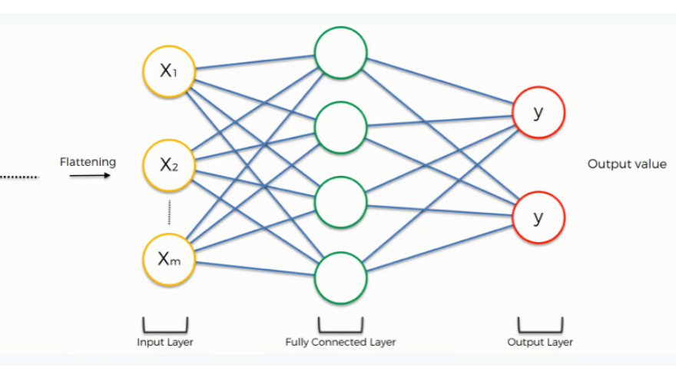
Interpreting image data through fully connected layers:
Interpreting image data to neural networks through fully connected layers is a method in which the tensor of an image is flattened to from a single dimensional array of pixel values. This single dimensional array of pixel values is treated as input features ‘x’ to the first fully connected layer followed by fully connected hidden layers and an output layer.

Slide 6
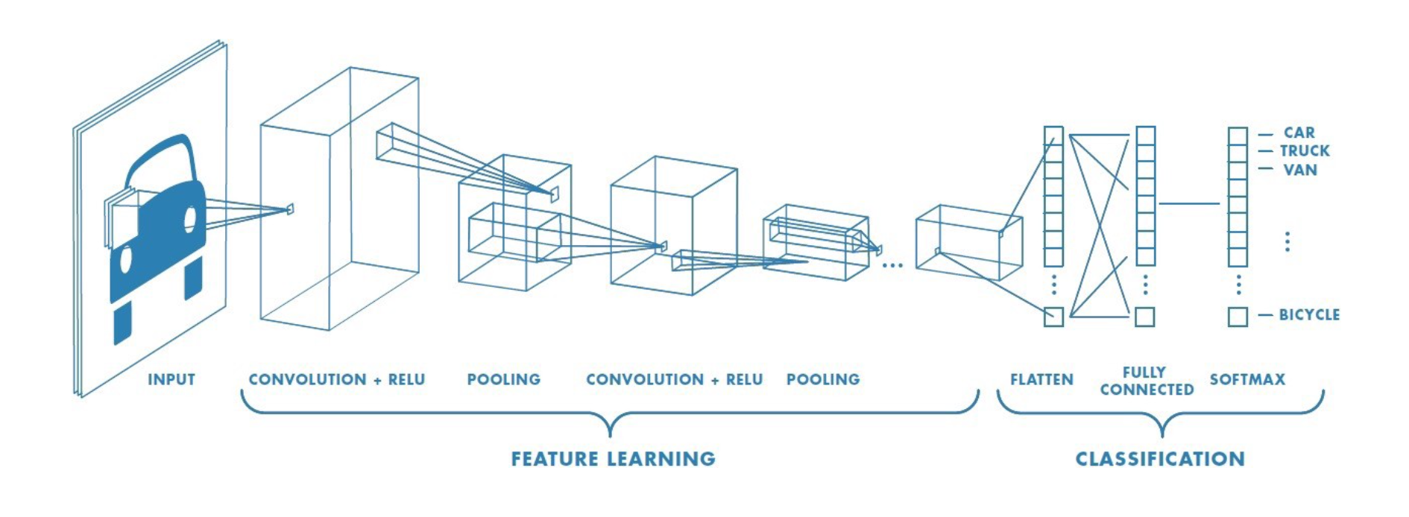
Interpreting image data through convolutional layers :
Interpreting image data to neural networks through convolutional layers is a method in which the tensor of an image is passed through series of convolutional layers, pooling layers to from a lower dimensional representation of image. This lower dimensional representation of image is flattened to a single dimensional array which is input features ‘x’ to the first fully connected layer followed by fully connected hidden layers and an output layer.

Slide 7
Introduction to novel method of image interpretation:
This paper introduces a new method to interpret unstructured data such as image data to neural networks so that the image data encoding becomes easier and efficient. Often Computer Vision applications tend to be large networks in order to generalize on unseen data. The similar tasks through IPFCII method can be performed by relatively smaller networks and compute resources without any tradeoff with the performance.
Inspiration of Frame-based Convolutional Image Interpretation:
The Idea of dividing down an image into corresponding frames before applying convolutional and pooling layers is inspired from the work of YOLO (you only look once) on object detection. The idea taken from the work YOLO is that the convolutional layers better understand simple images with small number of features than a full and complex image.

Slide 8

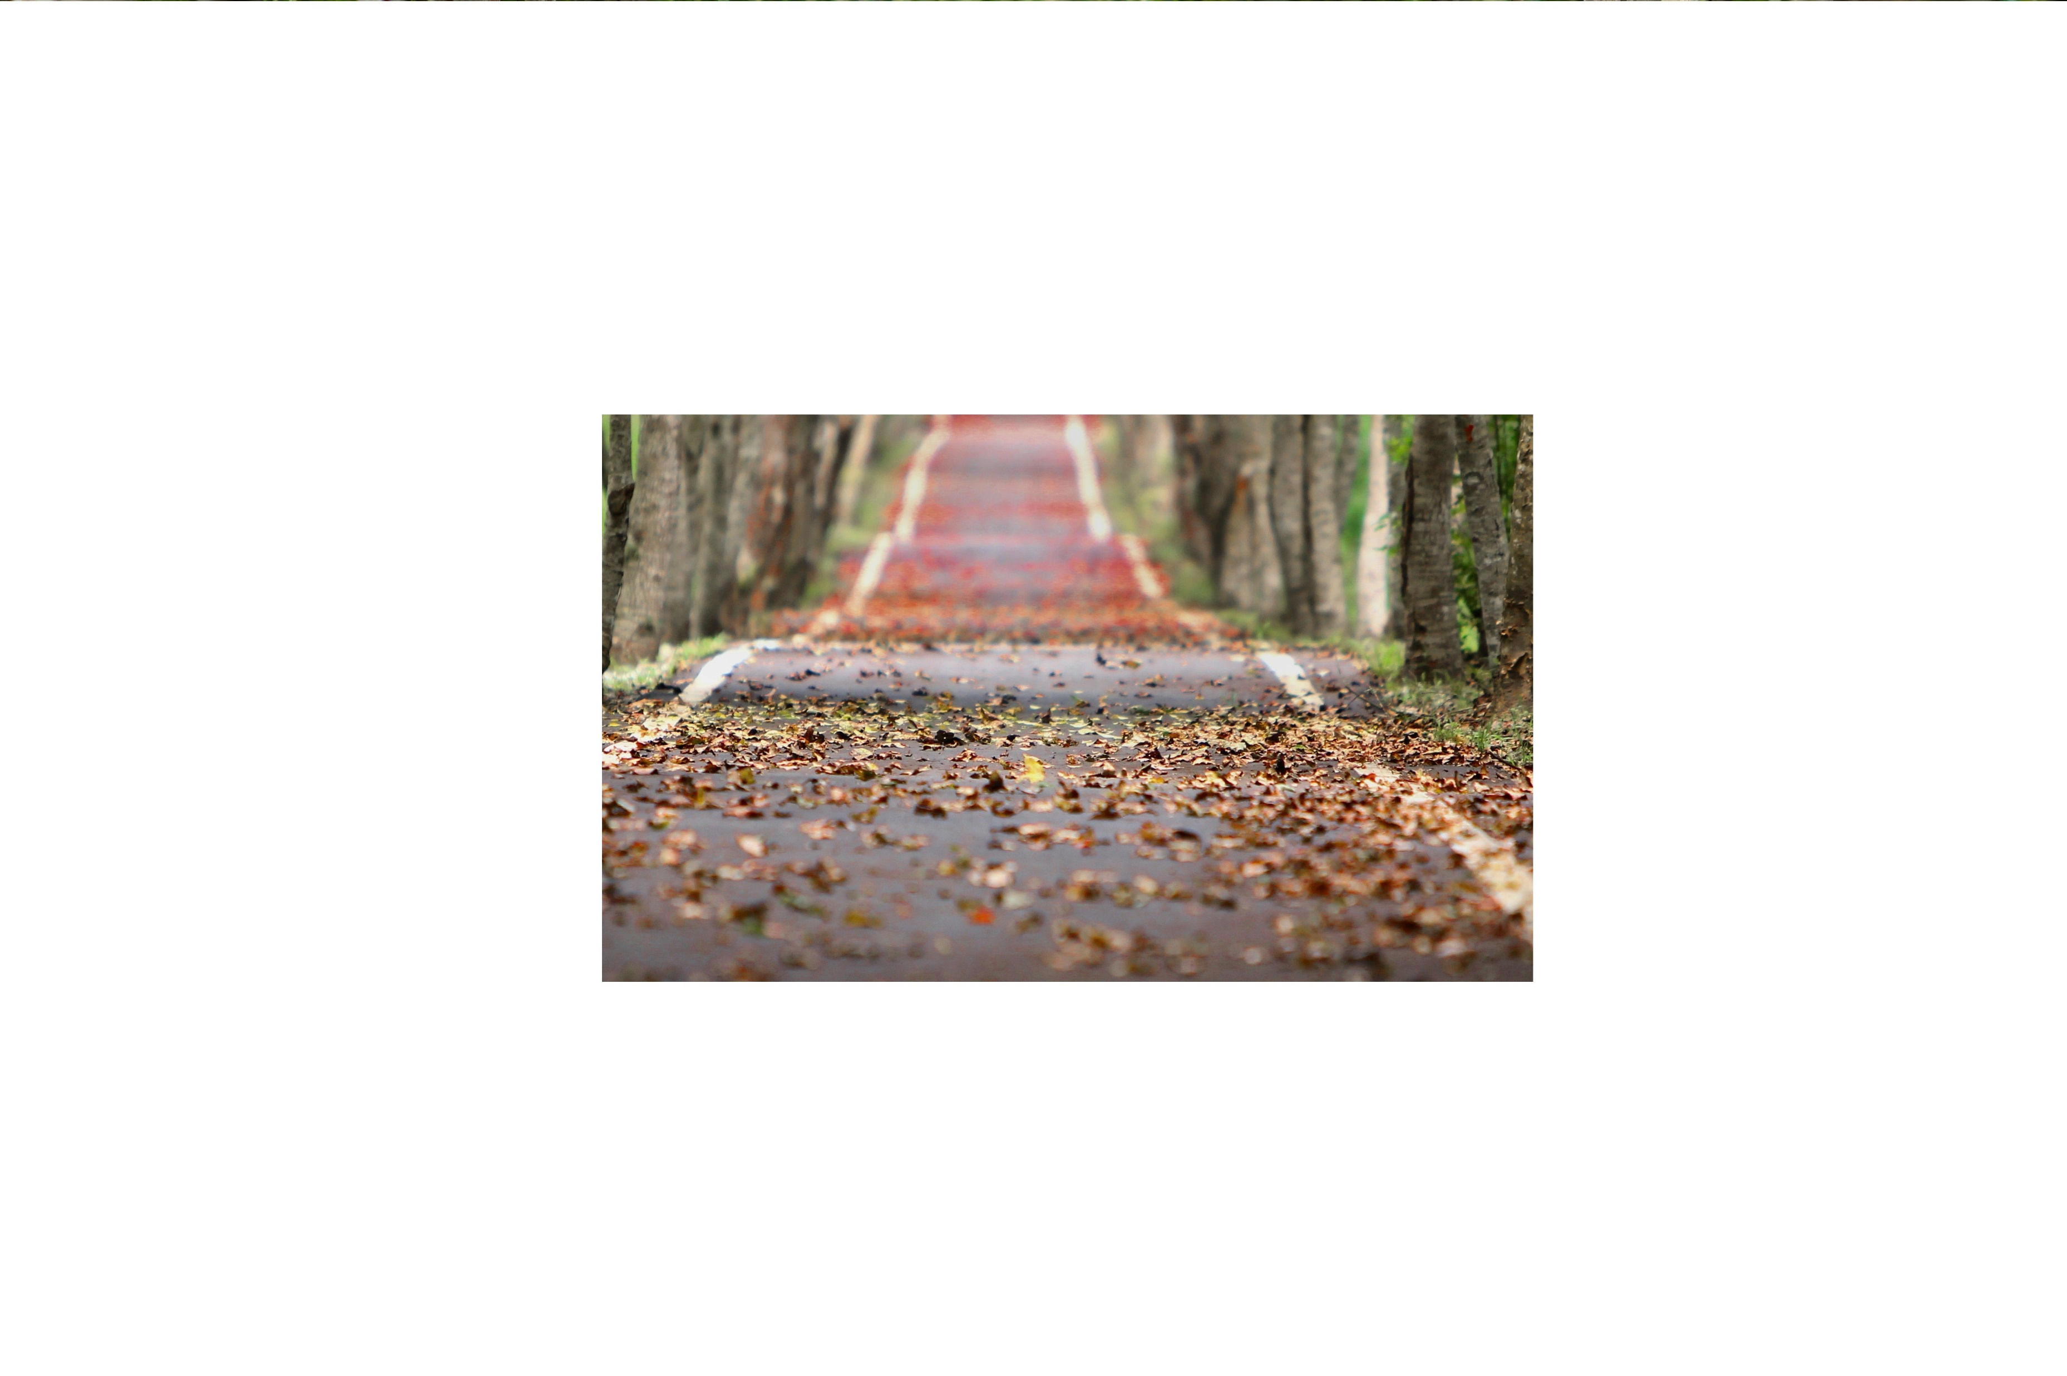
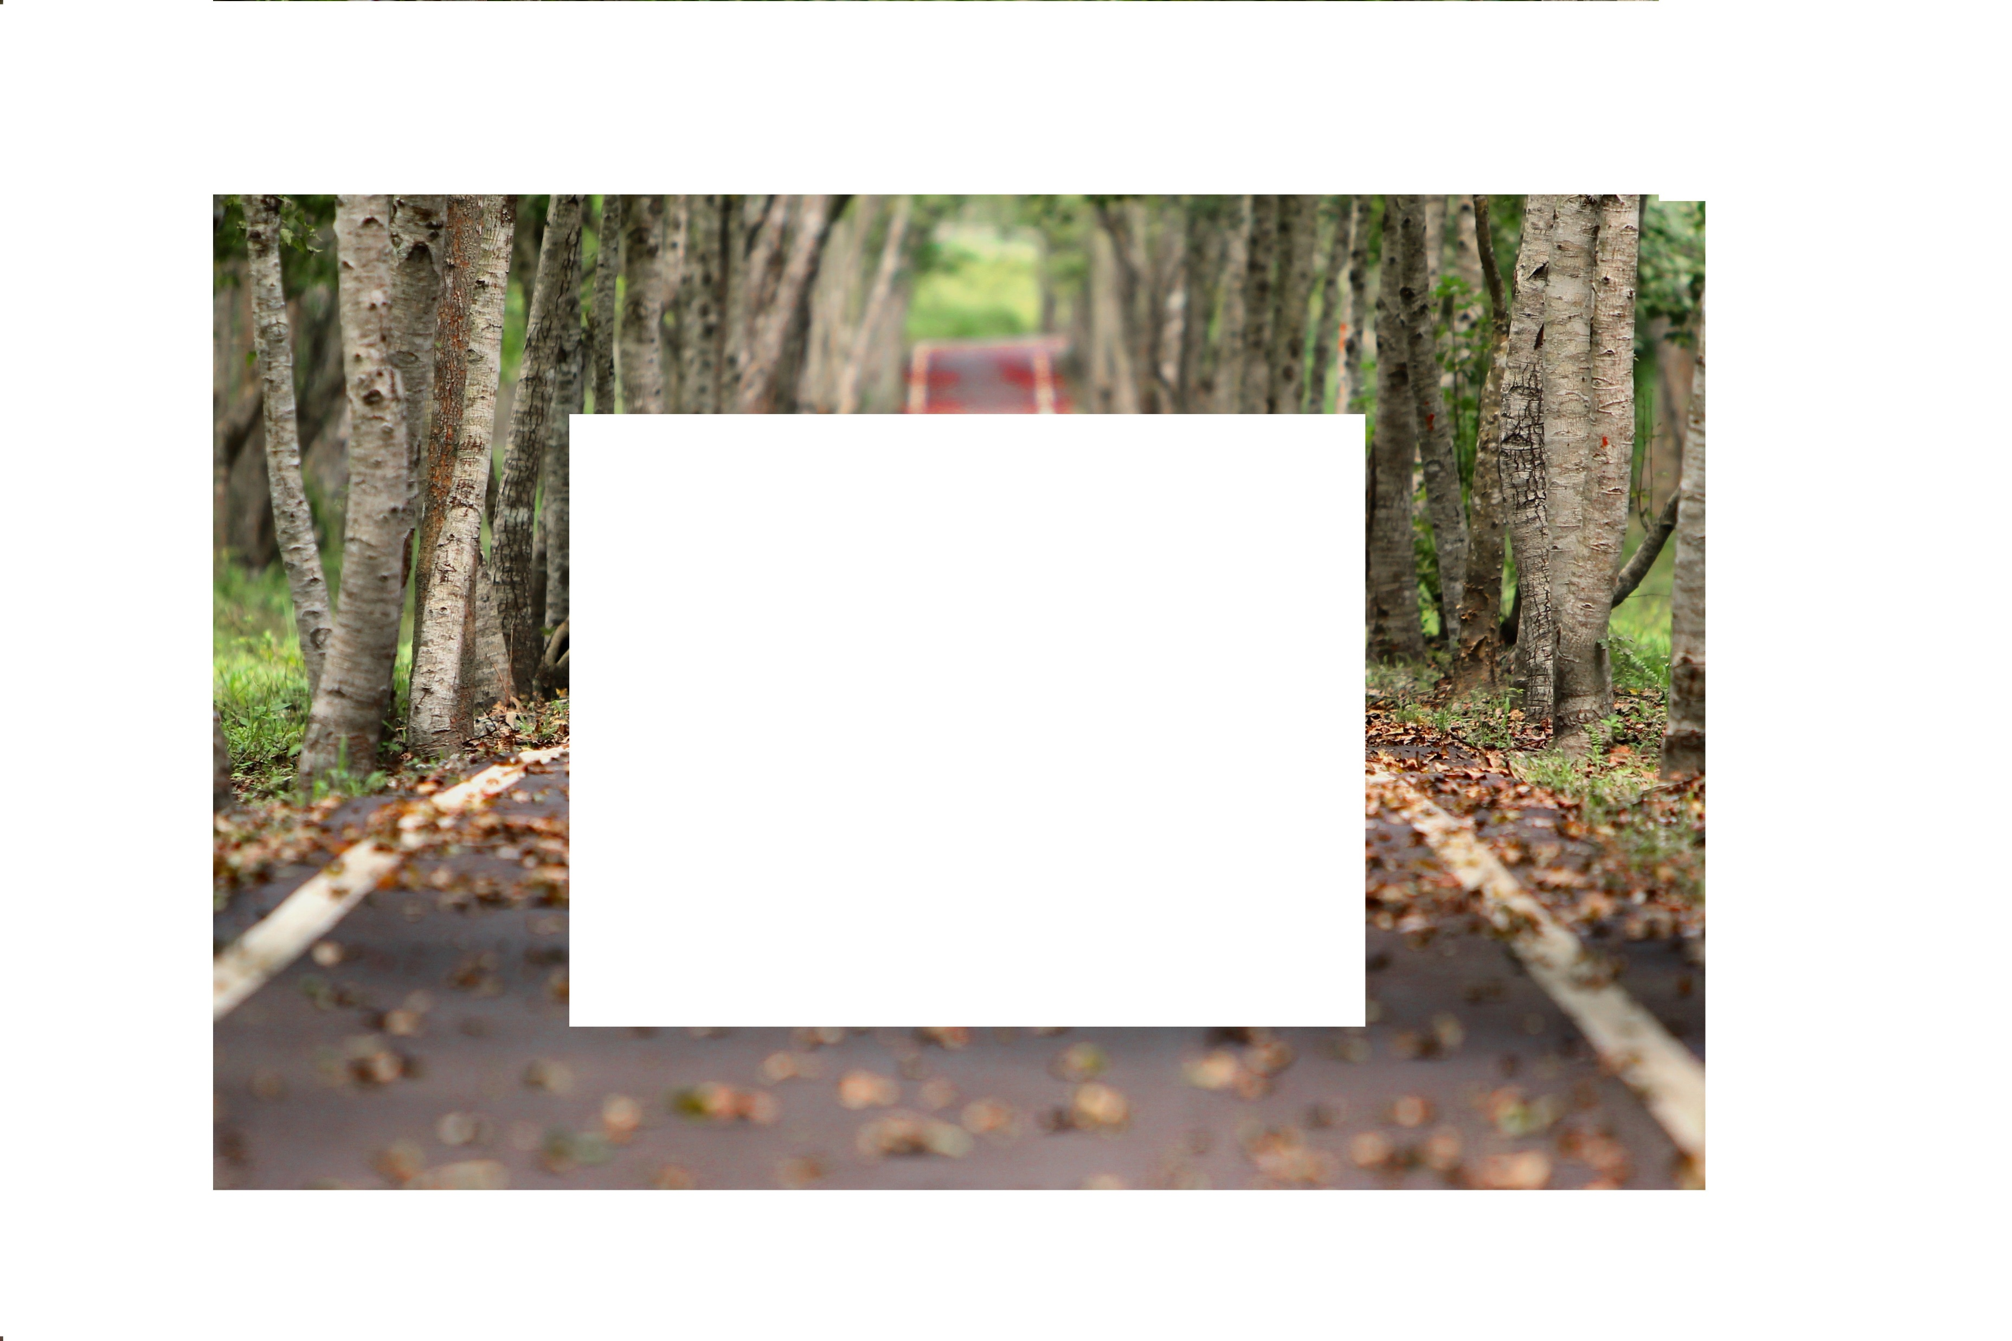
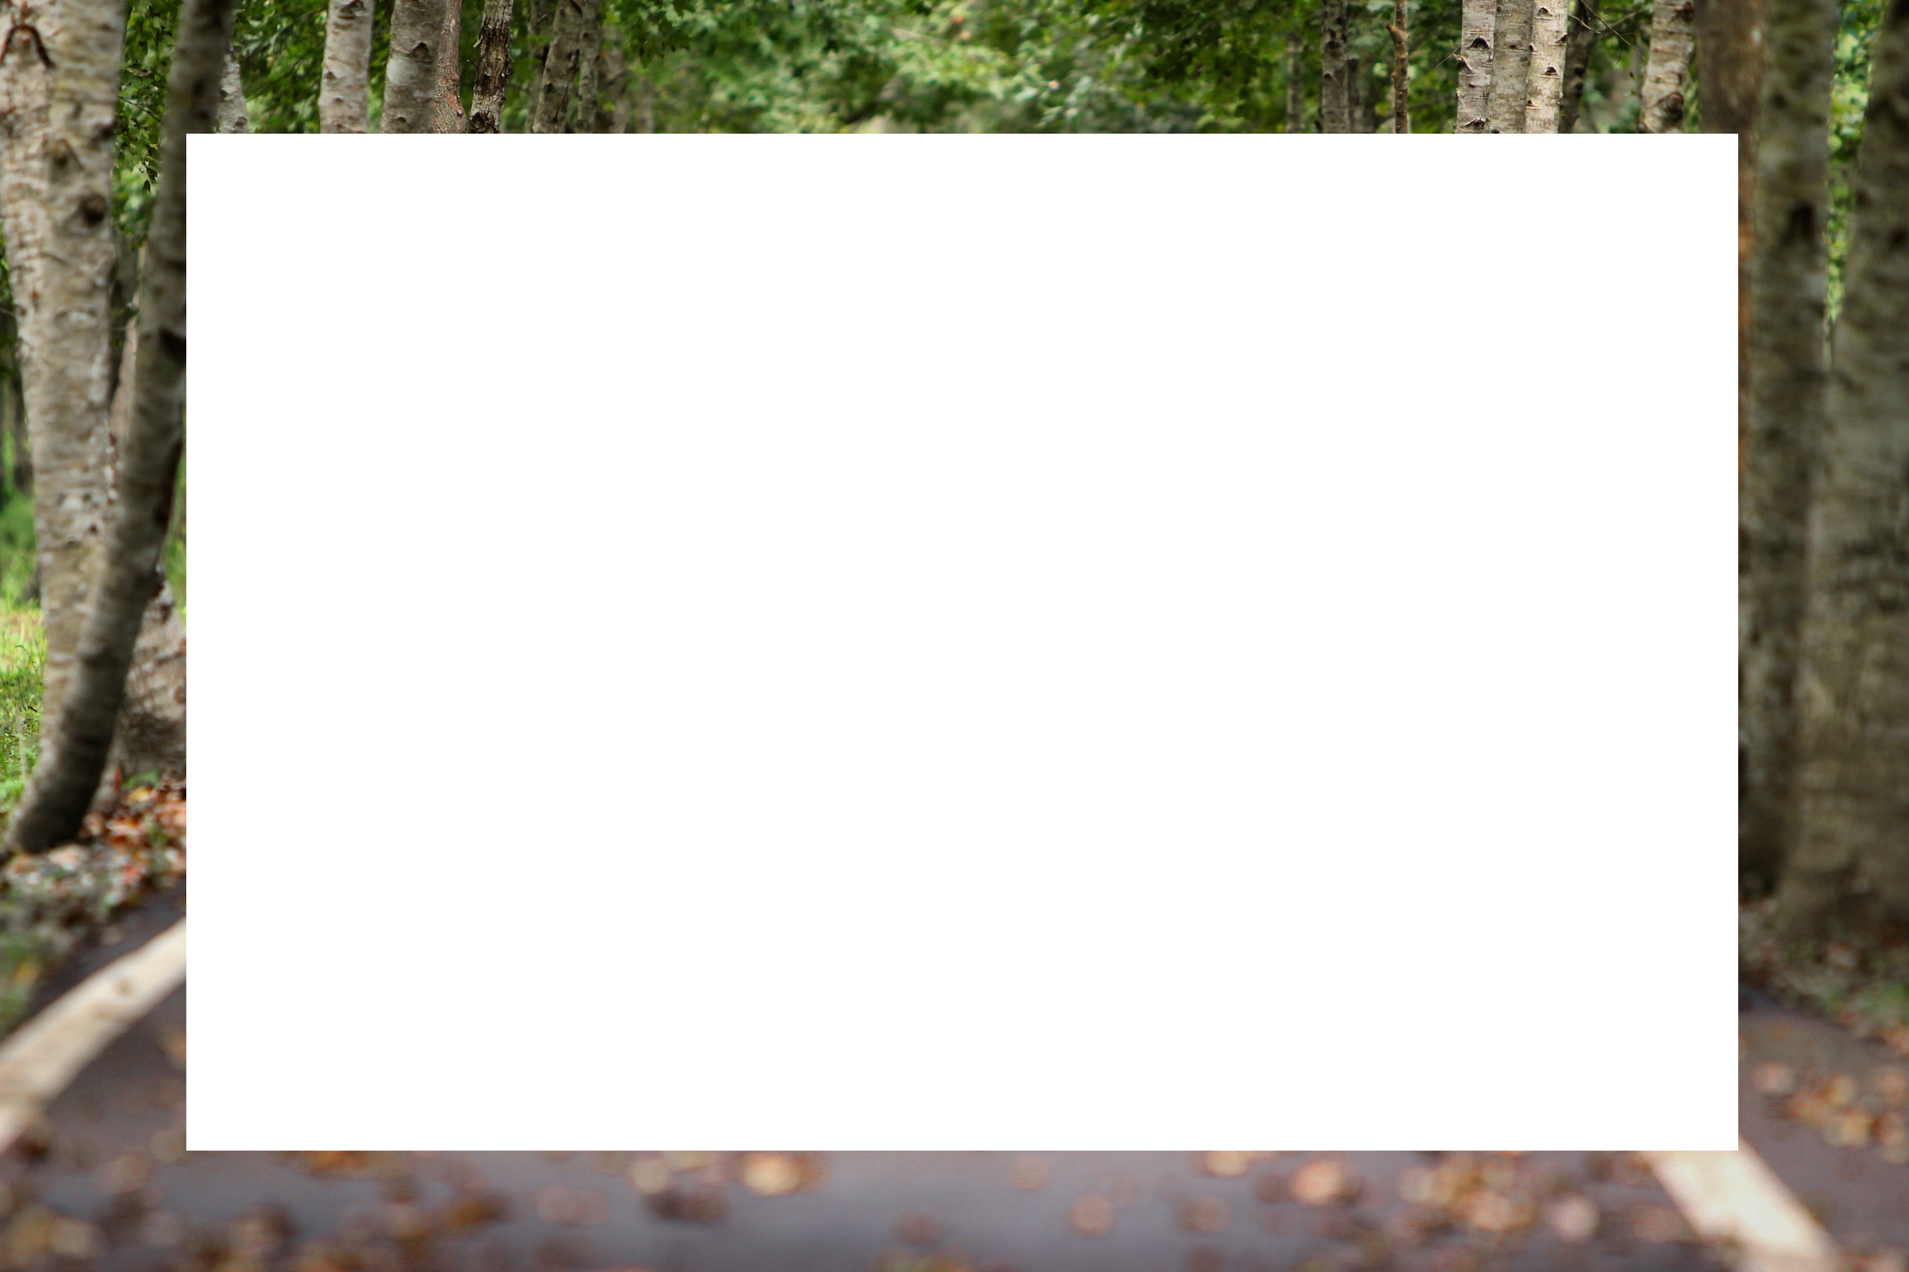
IPFCII method:

Slide 9
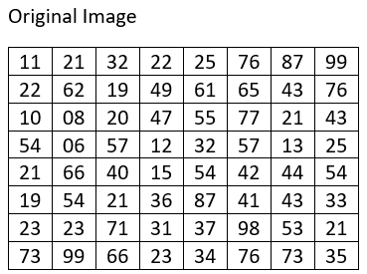
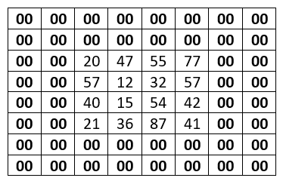
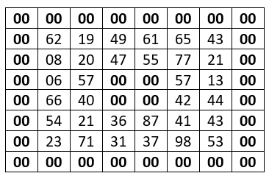
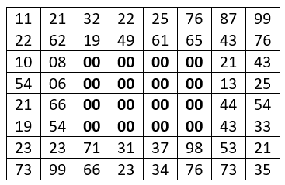
IPFCII method:

Slide 10
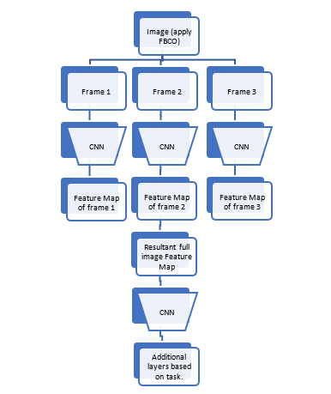
The Architecture of the IPFCII method:

Slide 11
Algorithm of IPFCII method:
Input an image
Apply frame based slicing operation after processing steps
// Formula used in dividing an image into frames is
no_frames = image_size/(stride_shift+stride_sharing)
4. Pass individual frames through a series of convolutional and pooling layers
5. The reduced mean of all the lower dimensional representations of corresponding frames is taken by
tf.reduce_mean(, axis=)
6. The obtained tensor is passed through at least a single convolutional layer to make sure no loss in pixel and their position information.
7. The additional layers are added based on the network’s task.

Slide 12
Advantages of this method over traditional convolution on complete image are:
The IPFCII method can improve the performance of neural networks on vision tasks by efficiently interpreting the image data.
The IPFCII method can reduce the compute cost while training a neural network by reducing the network size required to effectively carry out a task.
How the method IPFCII can improve the performance of any application?
The regular convolutional operation often tends to bottleneck the information or features of image while down sampling due to the fact that they are applied on whole image.
Apart from this, this idea of dividing a image into corresponding frames to apply convolutional layers can better encode features thereby easily generalizing to outliers or shifted distributions

Slide 13
How the IPFCII method can reduce the compute cost of training a neural network?
Regular convolutional layers often require large networks for the model to train well and generalize on unseen data but by the method of IPFCII, the convolutional layers can better interpret the image data i.e., features of image without any information bottleneck issues. Since the method can better interpret the image features to neural networks, the networks size required to learn and generalize on a vision task is relatively reduced thereby by reducing the compute cost to train the network.
Implemention details of the IPFCII method:
The method divides a complete image into corresponding frames. Convolutional neural network is applied on frames individually to encode the image into a lower dimensional representation. Formulating the function to divide the image, the equation that satisfies the parameters is,
no_frames = image_size/(stride_shift+stride_sharing)

Slide 14
Results:
The IPFCII method is applied on a basic dog breed classification task with a pre-trained network “inception”. The method has worked well on the task with relatively improved performance and reduced computational cost for training. Since the model is just fine-tuned so the exact compute cost it can reduce is unclear but the performance is definitely improved from 92% to 95%.
Required tests:
The method has performed well on a classification task with a pre-trained model but there are many tests to conduct, some of the potential tests would be:
On classification or regression task with completely training from scratch
On regression task with a pre-trained model
On advanced computer vision applications like image generation, completion and etc.

Slide 15
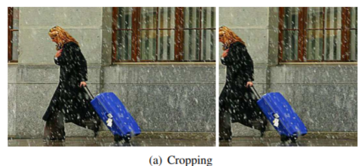
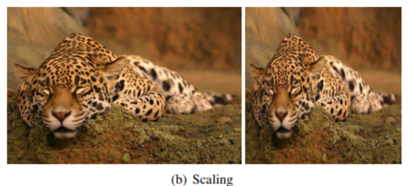
Future Research in data interpretation (On IPFCII):
So far the method is applicable on to images with shape (n, n) where n is any natural even number but in order to outperform all the existing models and adapted into vision research:
The method IPFCII need to be formulated and generalized to all shapes of image.
The IPFCII method need to be tested on supervised, unsupervised tasks mainly on generative models such as VAEs and GANs
The IPFCII method is tested only on pre-trained models but it need to be extended to training model from scratch.
Steps towards achieving generalizability:
In order to generalize the idea of IPFCII on differed shaped images, a multi-level spatial pooling method is incorporated from the paper titled “Composition-preserving Deep Photo Aesthetics Assessment”.

Slide 16
Thank you for attending my presentation.
Q/A is invited!

